Slide 1


Chess v0.1.2
A waste of time project by g

Slide 2
To do:
Activator circles
Notes:
To do list

Slide 3










Notes:
Piece tracking

Slide 4
Notes:
board

Slide 5
A
B
C
D
E
F
G
H
1
2
3
4
5
6
7
8
1
2
3
4
5
6
7
8
A
B
C
D
E
F
G
H
Notes:
MIAN

Slide 6
A
B
C
D
E
F
G
H
1
2
3
4
5
6
7
8
1
2
3
4
5
6
7
8
A
B
C
D
E
F
G
H
Notes:
Activator template
=DO NOT EDIT=
-for copy paste only-

Slide 7
A
B
C
D
E
F
G
H
1
2
3
4
5
6
7
8
1
2
3
4
5
6
7
8
A
B
C
D
E
F
G
H
Notes:
Piece stack template
=DO NOT EDIT=
-for copy paste only-

Slide 8
Notes:
Piece stack

Slide 9
A
B
C
D
E
F
G
H
1
2
3
4
5
6
7
8
1
2
3
4
5
6
7
8
A
B
C
D
E
F
G
H
Notes:
Idk what this is – maybe its just testing copy

Slide 10
Experimentals

Slide 11
Move piece trial

Slide 12
Safe keeping

Slide 13
A
B
C
D
E
F
G
H
1
2
3
4
5
6
7
8
1
2
3
4
5
6
7
8
A
B
C
D
E
F
G
H

Slide 14
A
B
C
D
E
F
G
H
1
2
3
4
5
6
7
8
1
2
3
4
5
6
7
8
A
B
C
D
E
F
G
H

Slide 15
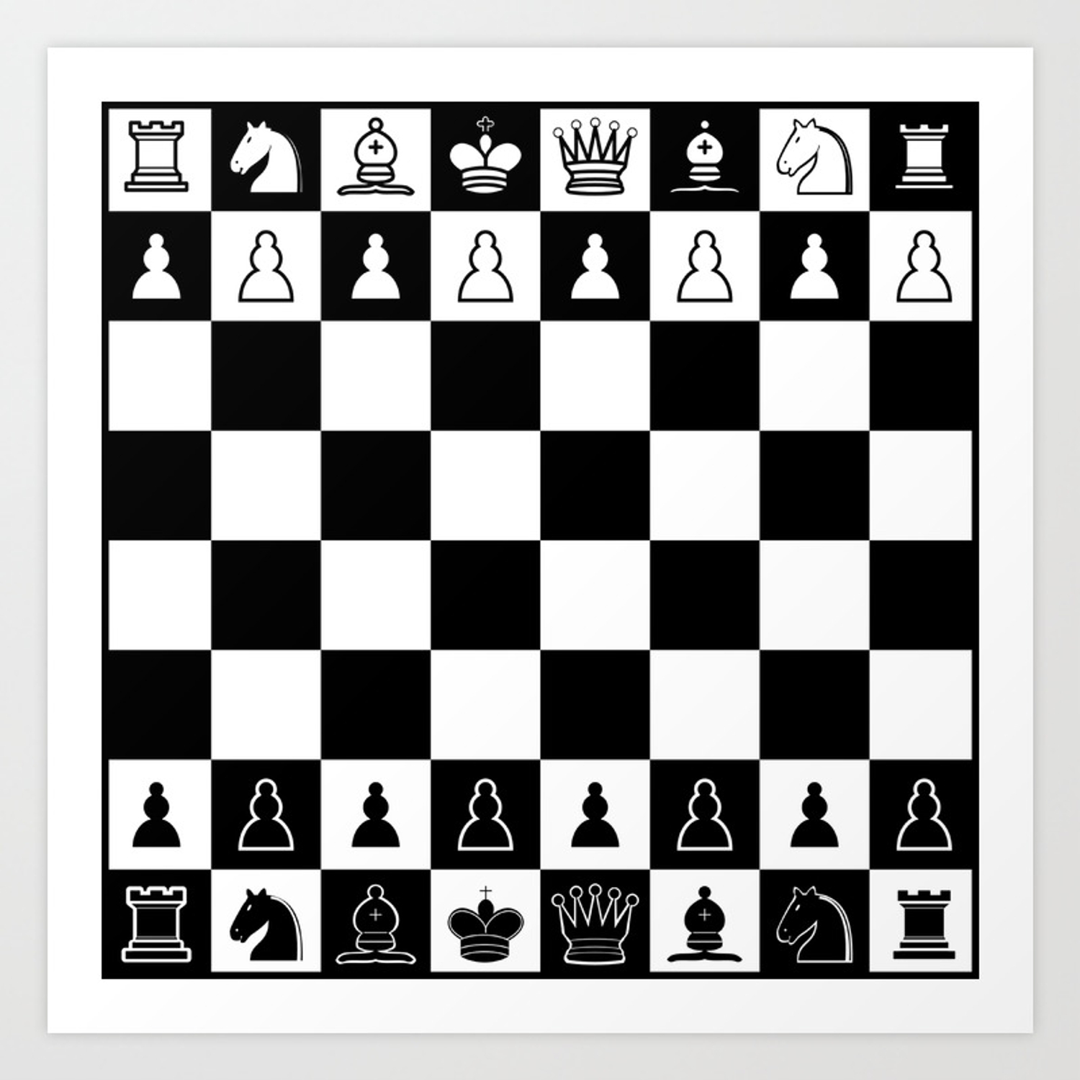

Slide 17


